Slide 1

OBJECT PROXIMITY/RADAR DETECTION SYSTEM
Group 14:
Isheet Shetty
Vijaya Neeharika Rangisetty
Bhavana Nettam

Slide 2
why
In today’s world it has become a necessity to keep some objects at a particular distance for safety reasons
For example, in museums generally the artifacts are either kept in an enclosed box or the tourists are enforced to keep a certain distance from the artifact
If the person’s proximity is decreased, an alarm goes off.
This project is made keeping in mind the low budget of implementation and ensuring that people who can come close enough can view the artifact but not too close such that it can harm the artifact or be vulnerable to stealing it.

Slide 3
About the project
This project is an object detection system that uses an ultrasonic sensor to figure out the distance of a particular object from the sensor.
This sensor can be mounted on a servo motor with either a 180 or 360-degree rotation angle to detect the proximity of its objects in its nearby vicinity.
If the sensor detects any objects, then the following instructions are followed:
Led turns red
The buzzer starts buzzing
The radar shows red in the degrees of the object
If the object shifts/ there Is no object detected
Led turns green
The buzzer does not beep
The radar shows green in the degrees of the object

Slide 4
components
Ultrasonic sensor (HC SRO4) (range 2 cm to 400 cm)
Servo motor
Beagle bone black
Bread board
Resistors
Jump wires
LED
Buzzer

Slide 5
Set up
To set up the entire project we plan to
Connect the beagle bone to a computer
Connect the beagle bone to a servo motor
Connect the beagle bone to the ultrasonic sensor
Mount the ultrasonic sensor on the servo motor
Connect the led to beagle bone
Connect the buzzer to the beagle bone
Make sure all the components are working simultaneously together
Radar is being displayed on the computer

Slide 6
working
The project works in the following ways
The servo motor either rotates continuously 180 or 360 degrees
The ultrasonic distance sensor keeps on measuring the distance of objects as it rotates mounted on the servo motor
The led blinks green, the radar on the screen also displays green and there is no buzz from the buzzer until n unless the ultrasonic sensor detects an object
As soon as the ultrasonic sensor detects the object the led turns red the buzzer starts beeping n the degree to which the object is present starts displaying red on the monitor
As soon as the object shifts from the range of proximity sensor led blinks green, the radar on the screen also displays green and there is no buzz from the buzzer

Slide 7
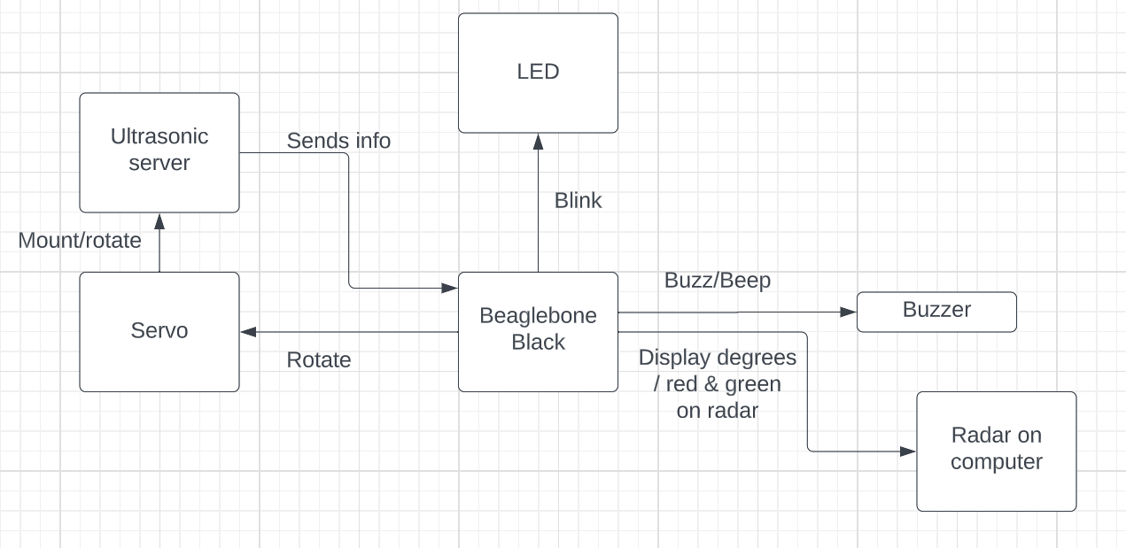
Diagram

Slide 8
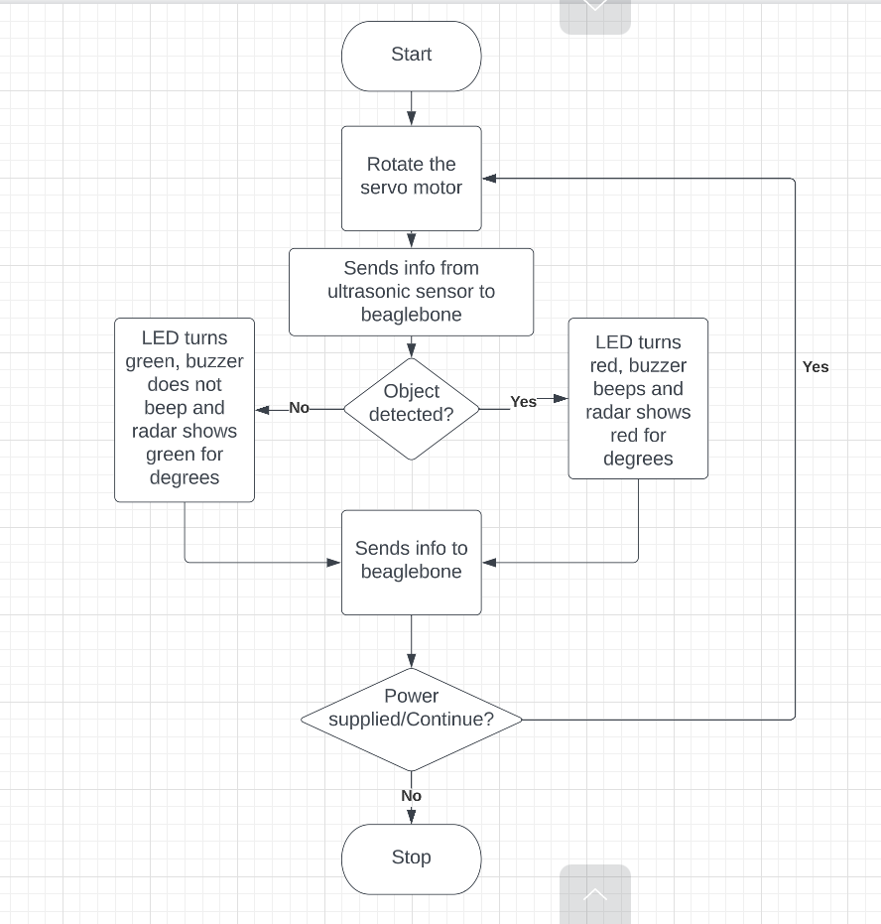
Flow chart

Slide 9
Schedule following agile development
Date/Week | To do
02/13 | Project proposal
02/20 | Requirements and component gathering
02/27 | Connect the beagle bone to a computer
03/06 | Connect the beagle bone to a servo motor
03/13 | Connect the beagle bone to the ultrasonic sensor
03/20 | Mount the ultrasonic sensor on the servo motor
03/27 | Connect the led to beagle bone, Connect the buzzer to the beagle bone
04/03 | Code for the already connected components
04/10 | Radar is being displayed on the computer
04/17 | Make sure all the components are working simultaneously together
04/24 | Final code review, bugs , glitches
05/01 | Testing phase -range of sensor and accuracy and working of project
05/08 | Final submission

Slide 10
Conclusion
In this Project using a beagle bone, a servomotor, and an ultrasonic sensor we will create a radar system that can detect the location and distance of any object in its radius. This method may be utilized in robotics for object identification and avoidance, as well as intrusion detection for various sizes of locations. The system's range is determined by the type of ultrasonic sensor that is employed. The sensor we plan to use is the HC-SR04, which has a range of 2 to 400 cm.

Slide 11
Thank you
Email: neeharika.vijaya@gmail.com isheetshetty@gmail.com bhavana.190301@gmail.com

Slide 12
references
A Short-Range Radar System Using Arduino Mohamed Naji Muftah1, Ismail Saad Ali2 and Abdalghani OmarAbdalla
Radar system using Beaglebone and ultrasonic sensor Shreyes Mehta, Shashank Tiwari
G. Bhor, P. Bhandari, R. Ghodekar and S. Deshmukh, "Mini Radar," International Journal of Technical Research and Applications, pp.68-71, 2016.
D. B. Kadam, Y. B. Patil, K. V. Chougale and. S. S. Perdeshi, "Arduino Based Moving Radar System," International Journal of innovative Studies in Sciences and Engineering Technology (IJISSET), vol. 3, no. 4, pp. 23-27,2017.

